Slide 1

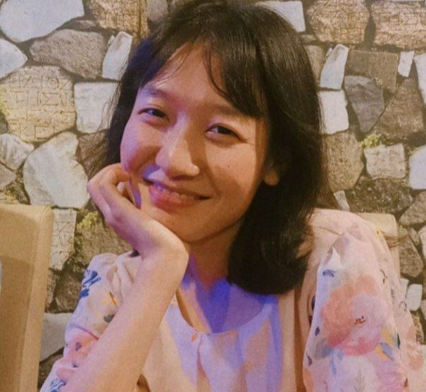
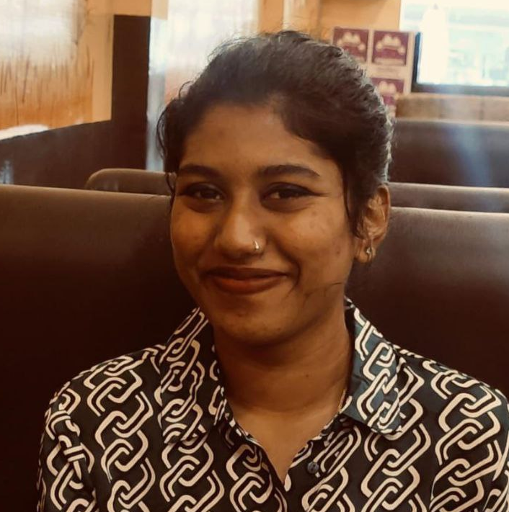
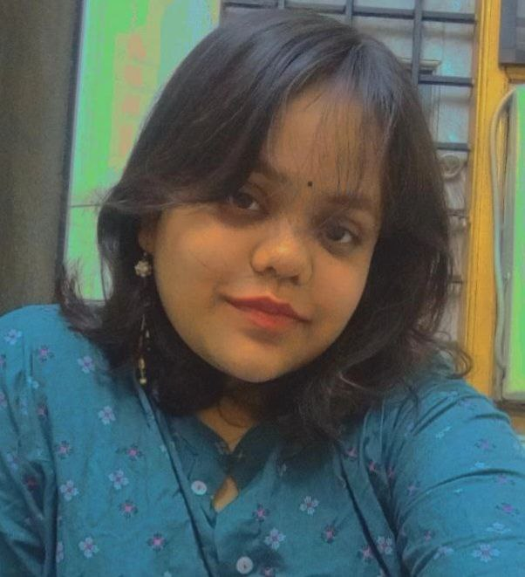
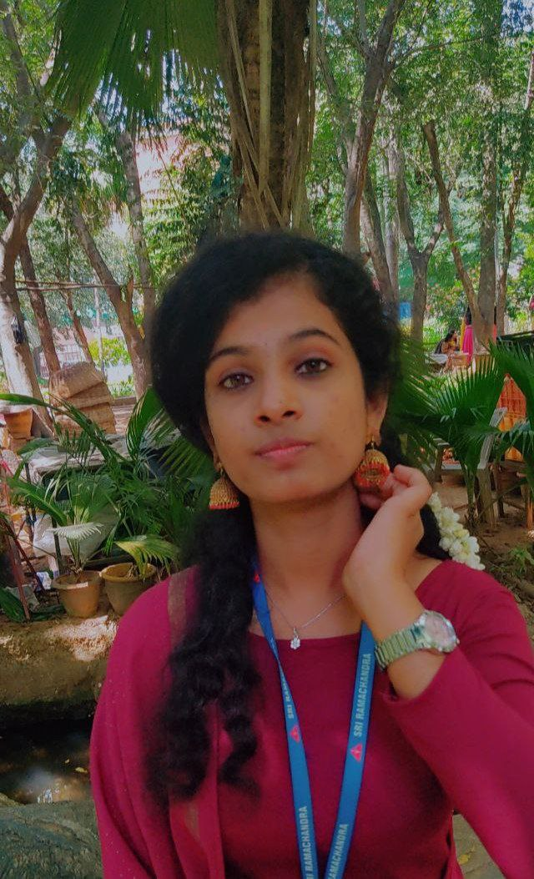

Tourism
[Website]
HACK-24-THON PRESENTATION
TEAM NAME [YARM]
YUDILA
E6221023
AHALYA
E6221021
RAUNAK
E5221015
MONIKA
E5221028

Slide 2
TOURISM
ABSTRACT
As tourism is one of the fastest growing industries today, thus within the tourism industry events are getting more and more important. People have become more interested in events of all kinds, and will travel far away to participate in events that they find interesting. Events can offer various economical and social benefits for destinations, and therefore destination managers can and should employ events effectively in a tourism role.

Slide 3
TOURISM
PROBLEM STATEMENT
In Tamilnadu, tourism has been rising but people are still having problem in finding the best tour destination. We made Kovil Nilam website for tourists that helps them to find the best destinations among many.

Slide 4
TOURISM
WORKFLOW / METHODOLOGY
Information Collection.
Data Collection.
Implementation of html and css on Visual Studio.
Added website links for better guidance of the tourists.

Slide 5
TOURISM
INNOVATIVENESS AND UNIQUENESS
This slide must explain, why you have chosen this problem statement, what does your solution offer that the existing solutions lack to offer, what makes your project unique, what are your own thoughts that you've implemented in the project to provide an solution to your problem staement.

Slide 6
TOURISM
SCOPE AND SCALABILITY
We are hoping that the tourism in Tamilnadu becomes more accessible. Tourism is really trending and it benefits economy of Tamilnadu and its local vendors.

Slide 7
TOURISM
APPLICATIONS IN REAL WORLD
In this website we provide every information and necessary for tourists .We reduced time consumption and confusion regarding the basic things and arrangement .we let choose your own package and also let you find about Tamilnadu’s cultural and beauty

Slide 8
CONCLUSION
Our website ‘KOVIL-NILAM’ focuses to provide better experience to users for travelling and exploring Tamilnadu. It also helps in reducing time spend on searching places .
In future we have decided to add backend to our website for smooth responsive website and also adding more visting places in our website.

Slide 9
DEMO VIDEO
https://drive.google.com/file/d/1AnoXD2jKDLKhv-9KqcgRsE3Ag7m-F_eS/view?usp=sharing

Slide 10
TOURISM
PROJECT REPOSITORY
https://github.com/Yudila/yarm

Slide 11
Thank You

